Slide 1
Prosthetic Cover
ENGS 241 CAD
Varoujan Anbarson Lilit Yerknapeshyan Aspet Davoodi

Slide 2
Who is our target customer? How did that affect the implementation?

Slide 3
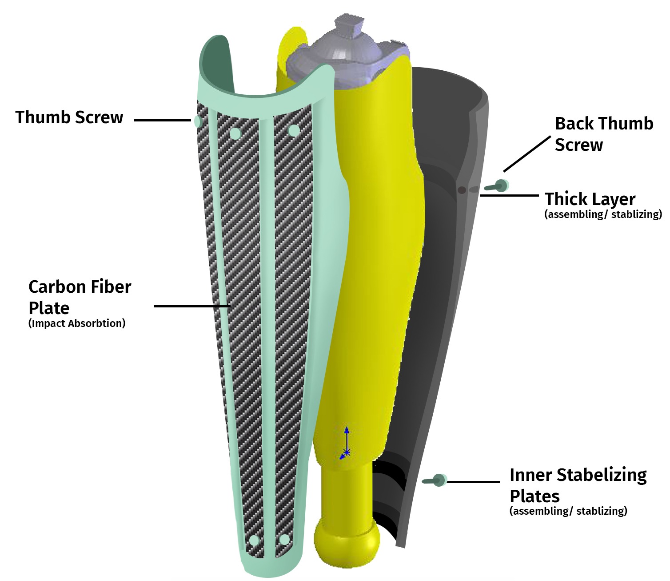

Slide 4
The Details of the Design

Slide 5
Materials
PETG
Carbon Fiber
Robust, Durable, Lightweight

Slide 6
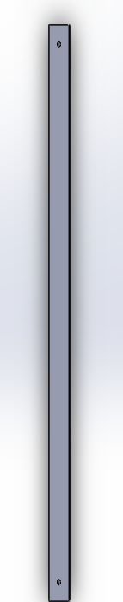
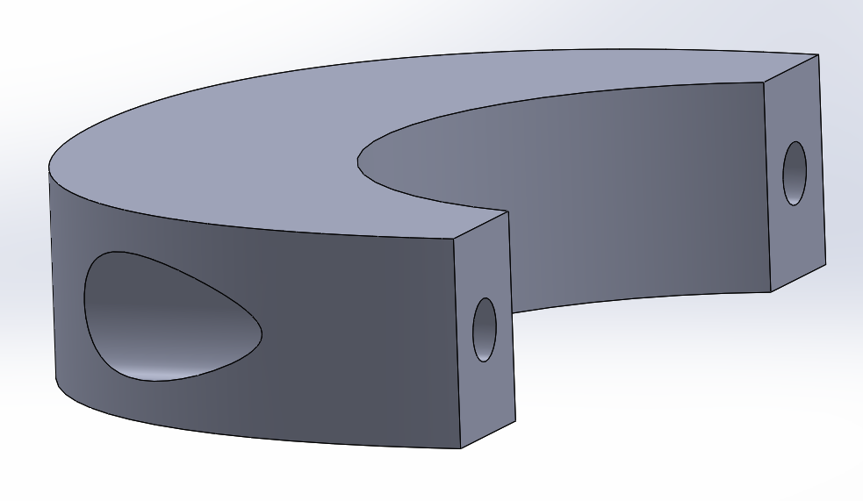
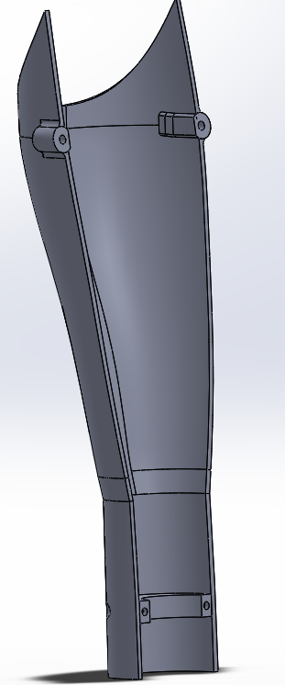
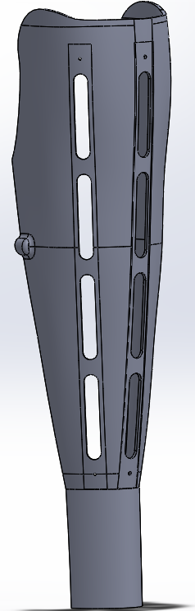
Parts
Cover consists of parts BACK and FRONT
Carbon fiber inserts are attached to the FRONT cover
A disk is used to position the FRONT cover on the prosthetic to make the assembling easier
Carbon Fiber plates

Slide 7
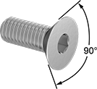
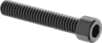
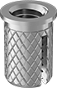
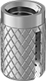
Parts for Assembling
Flat head screws
M4x0.7mm, M3.5x0.6mm, M3x0.5mm
Brass Screw-to-Expand inserts for attaching the covers to each other
Stainless steel flanged Screw-to-Expand inserts to attach the disk to the FRONT cover

Slide 8
How should our cover be assembled?

Slide 9

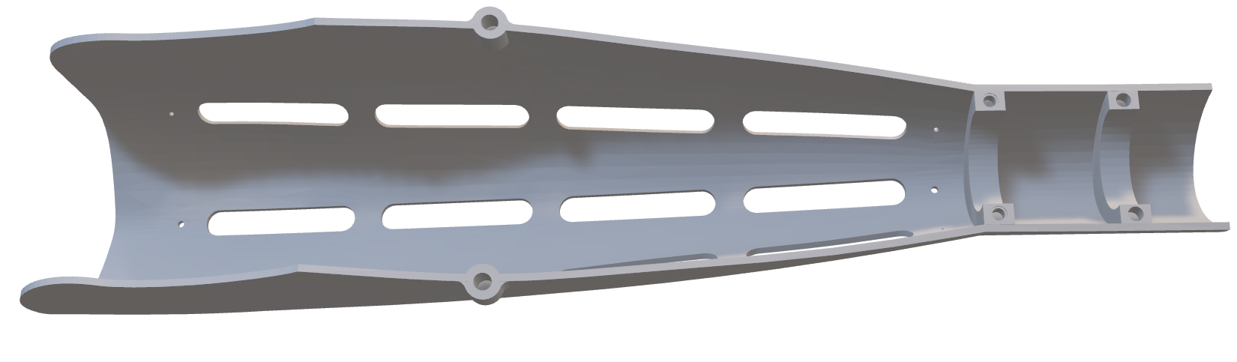
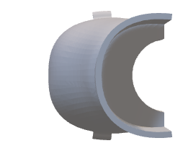

Slide 10
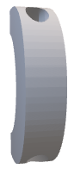

Slide 11

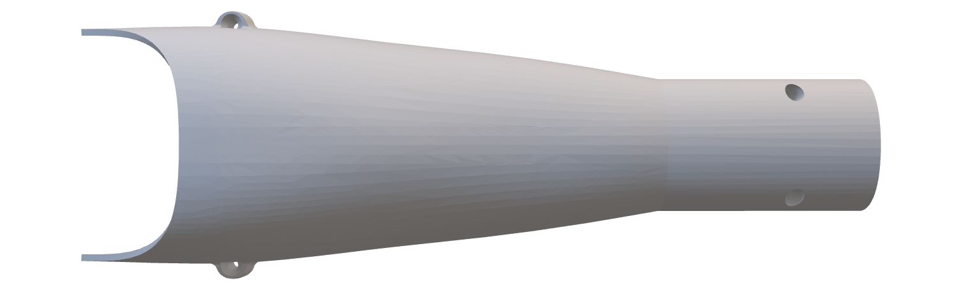

Slide 12
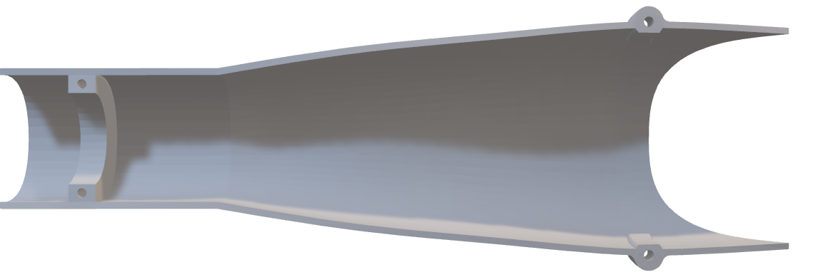
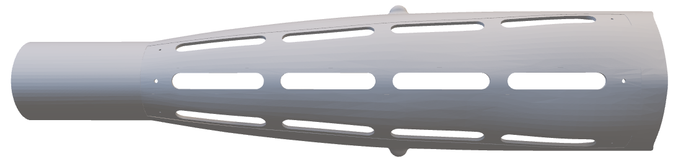


Slide 13
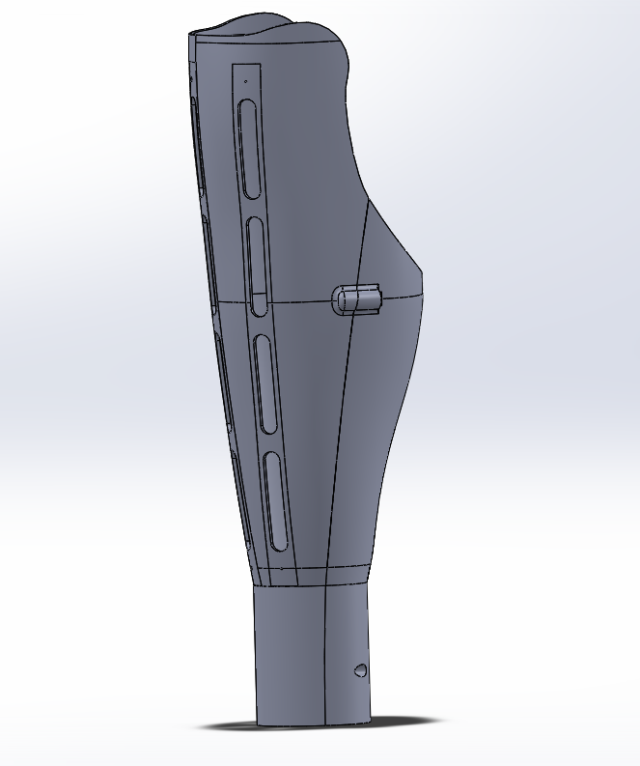
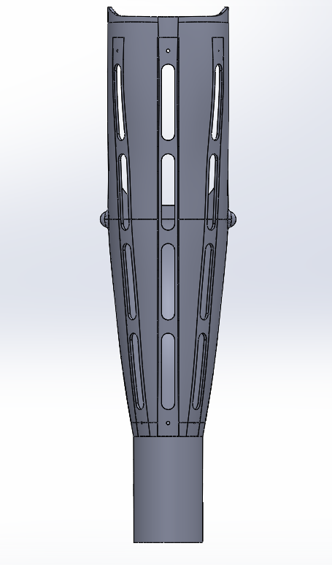
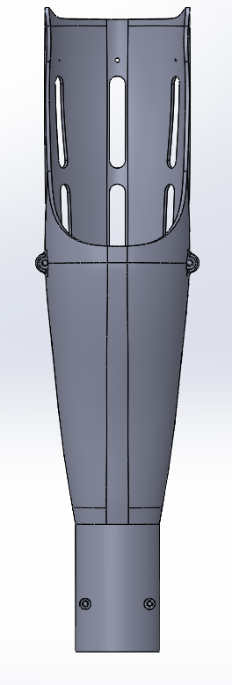

Slide 14
What were the alternatives?

Slide 15
Ideas we did not implement
Why not?
A tool compartment
Attach the carbon plates by just putting it inside the designated area, where a leap would hold the plates
Too much space
Does not coincide with the initial idea of the design

Slide 16
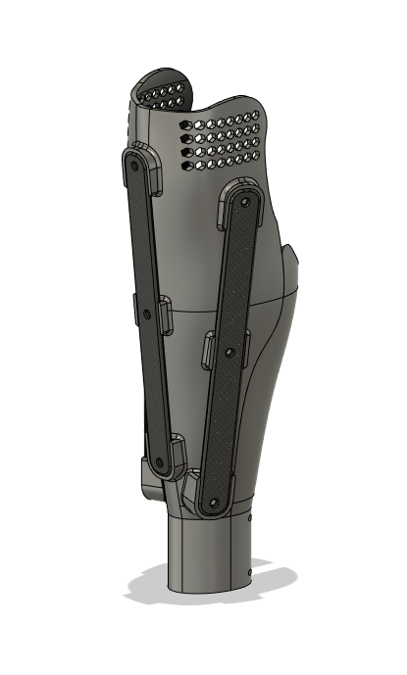
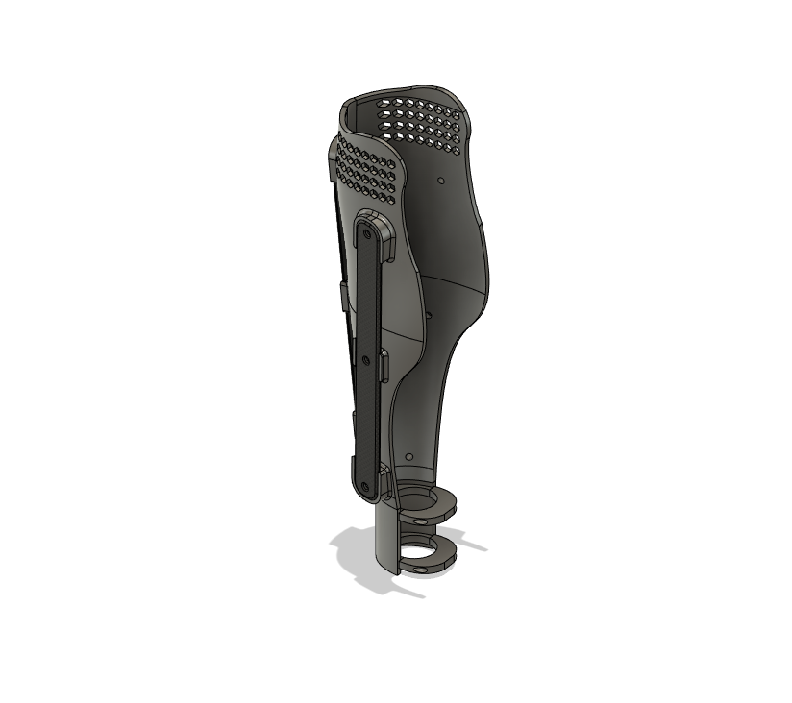
Last, but not least design

Slide 17
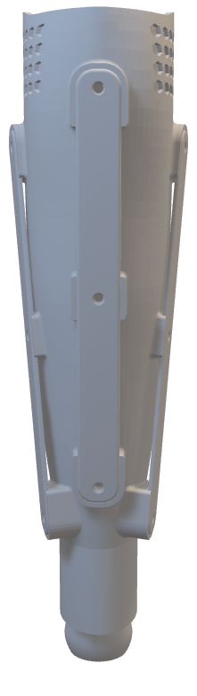

Slide 18
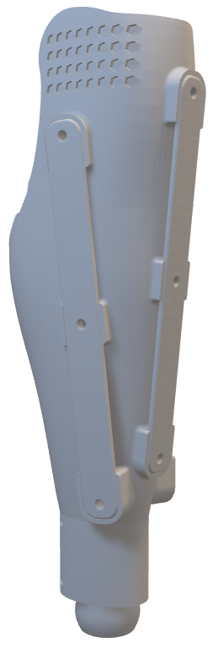

Slide 19
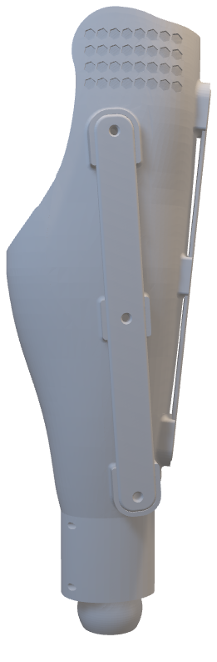

Slide 20
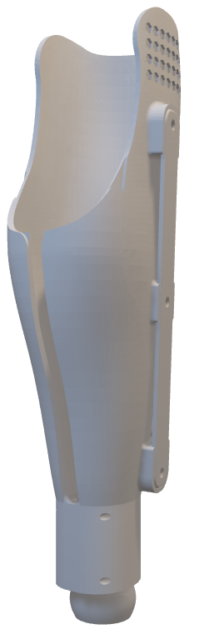

Slide 21
Thank You For Your Attention

